Slide 1

Prediction of Pedestrian Speed with Artificial Neural Networks
Kejia Gao (03779844)
Jingyi Zhang (03785924)
Maximilian Mayr (03738789)
Yizhi Liu (03779947)
Felipe Antonio Diaz Laverde (03766289)
08.07.2024

Slide 2
Contents
Background of the Research
Data preprocessing
Implementation of Weidmann model
Implementation of ANN model

Slide 3
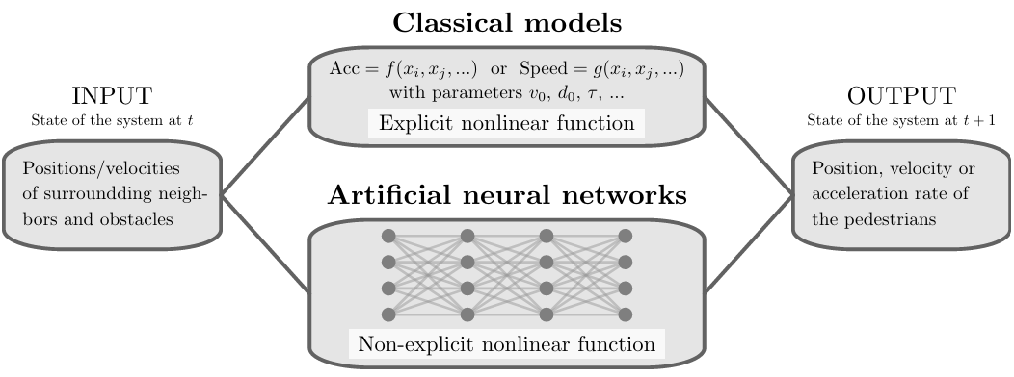
Background of the Research
"Prediction of Pedestrian Speed with Artificial Neural Networks"
by Antoine Tordeux, Mohcine Chraibi, Armin Seyfried, and Andreas Schadschneider (2018)
Tordeux A. et al. Prediction of pedestrian speed with artificial neural networks, 2018.

Slide 4
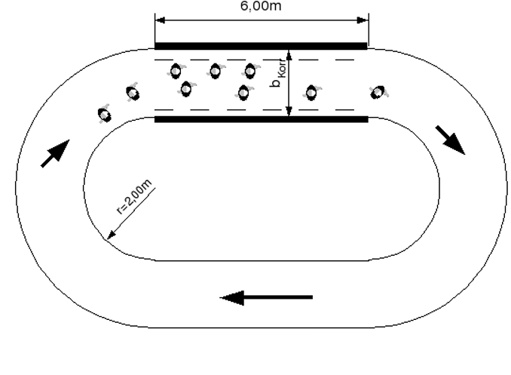
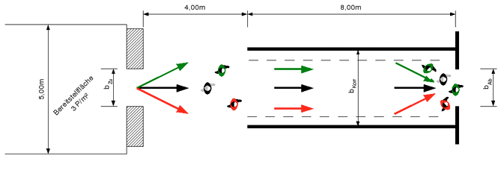
Background of the Research – Data
Project HERMES
Laboratory conditions
Unidirectional
Ring data
Bottleneck data
Sampling frequency 16Hz
50%/50% train-test-split
Keip C, Ries K. Dokumentation von Versuchen zur Personenstromdynamik “[J]. Project Hermes, Bergische Universit ̈at Wuppertal, Tech. Rep, 2009.

Slide 5
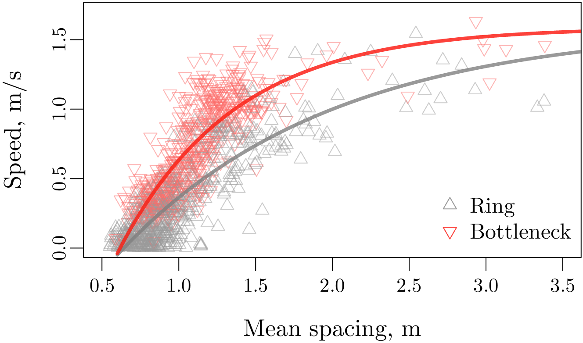
Background of the Research – Data
Tordeux A. et al. Prediction of pedestrian speed with artificial neural networks, 2018.

Slide 6
Background of the Research – Models
Weidmann model
$$v=v_{0}\left(1−\exp\left(\frac{l−{\overline{s}}_{K}}{v_{0}T}\right)\right)$$
Artificial neural network
$$v=NN\left(H, {\overline{s}}_{K},\left(x_{1}−x, y_{1}−y\right), …, \left(x_{K}−x, y_{K}−y\right)\right)$$

Slide 7
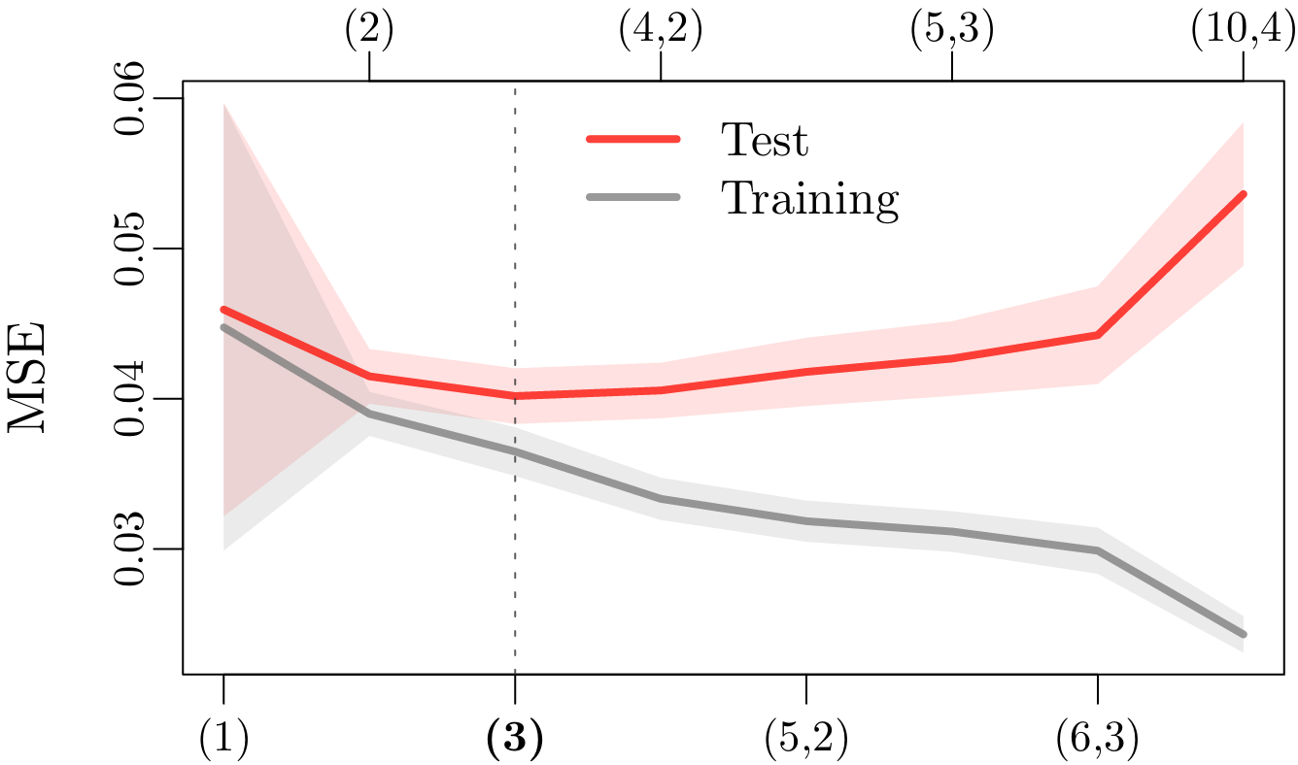
Background of the Research – Results
Tordeux A. et al. Prediction of pedestrian speed with artificial neural networks, 2018.

Slide 8
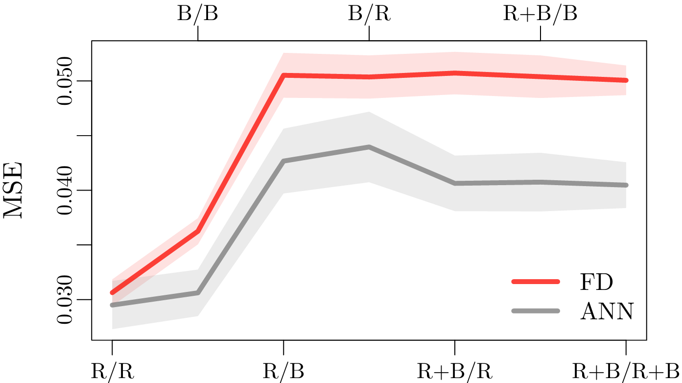
Background of the Research – Results
Tordeux A. et al. Prediction of pedestrian speed with artificial neural networks, 2018.

Slide 9
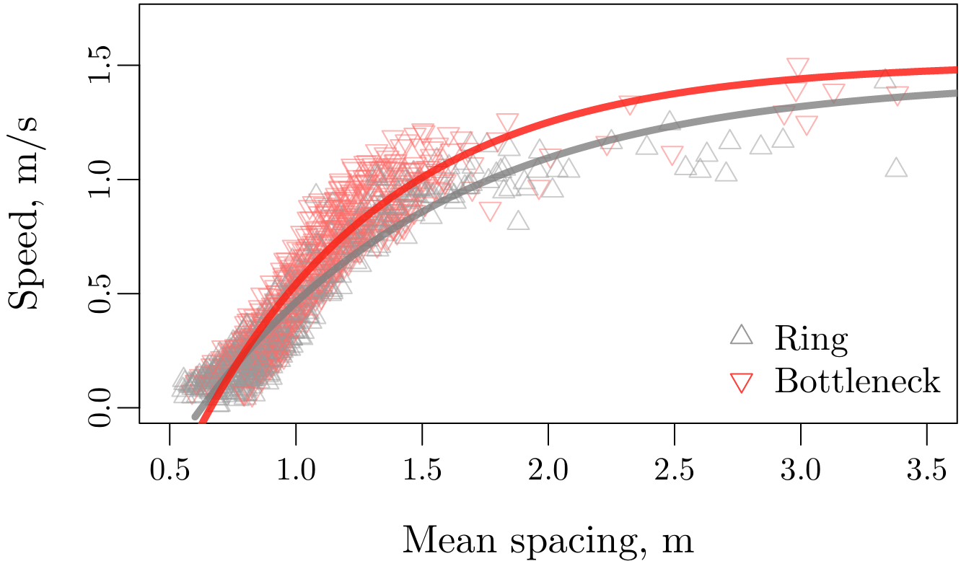
Background of the Research – Results
Tordeux A. et al. Prediction of pedestrian speed with artificial neural networks, 2018.

Slide 10
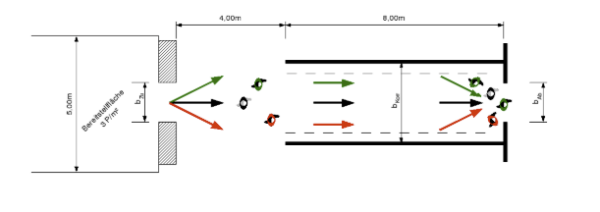
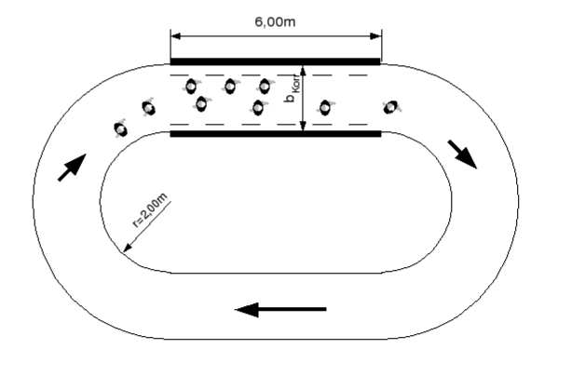
Data preprocessing
Dataset Overview: 2 scenarios
Bottleneck: The width of the system in front of the bottleneck is 1.8 m while the width of the bottleneck varies (from 0.70, 0.95, 1.20 to 1.80 m — 150 participants by experiment)
Corridor: Closed geometry of length 30 m and width 1.8 m for different density levels (the participant number ranges from 15 to 230)
Keip C, Ries K. Dokumentation von Versuchen zur Personenstromdynamik “[J]. Project Hermes, Bergische Universit ̈at Wuppertal, Tech. Rep, 2009.

Slide 11
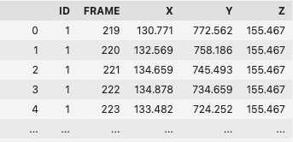
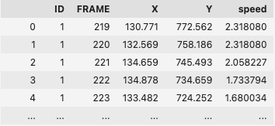
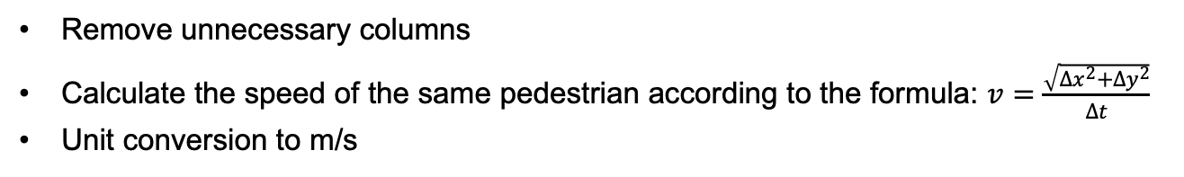
Data preprocessing
Adding speed:
Remove unnecessary columns
Calculate the speed of the same pedestrian according to the formula: $v=\frac{\sqrt{{∆x}^{2}+{∆y}^{2}}}{Δt}$
Unit conversion to m/s

Slide 12
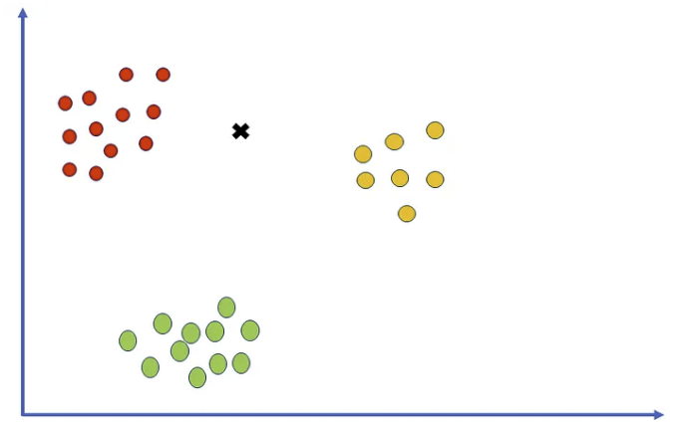

Data preprocessing
Finding nearest neighbors:
Grouping by Frame
Finds the 10 nearest neighbors for each point using Euclidean distance
calculates the mean spacing with the formula:
https://pub.towardsai.net/k-nearest-neighbors-knn-algorithm-tutorial-machine-learning-basics-ml-ec6756d3e0ac
Feature: Distance to neighbors, mean spacing (21-dimensioanal)
Target: Speed

Slide 13
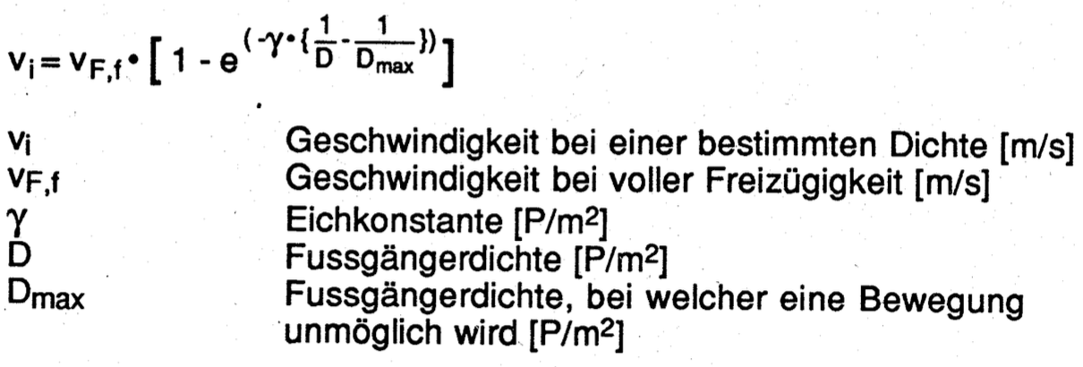

Implementation of FD Model – Weidmann Model
Original Weidmann model:
Modified model:
$$v=v_{0}\left(1−\exp\left(\frac{l−{\overline{s}}_{K}}{v_{0}T}\right)\right)$$

Slide 14
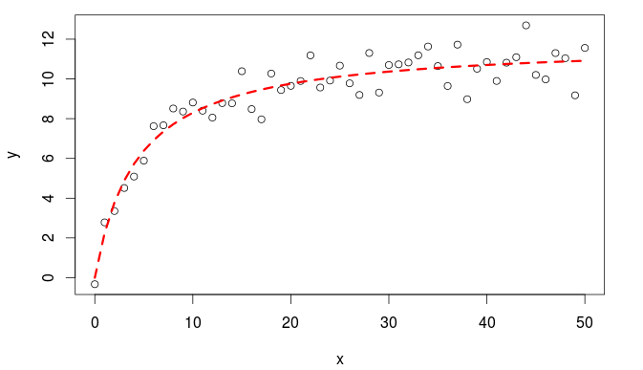
Implementation of FD model - non-linear least squares
https://datascienceplus.com/first-steps-with-non-linear-regression-in-r/

Slide 15
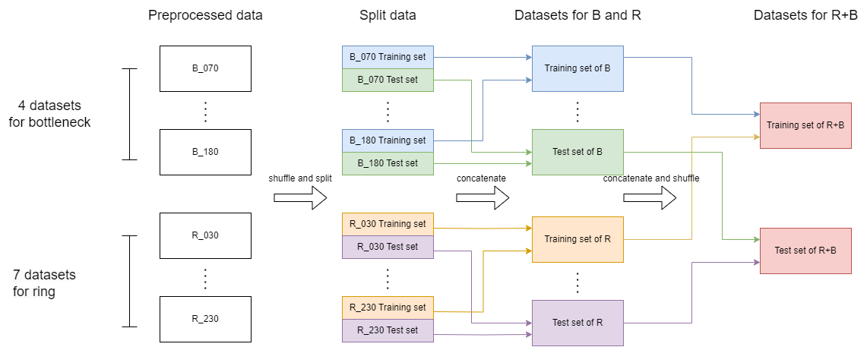
Implementation of ANN model – Training set and test set
Different combinations of training set/test set:
'R/R', 'B/B', 'R/B', 'B/R', 'R+B/R', 'R+B/B', 'R+B/R+B'

Slide 16
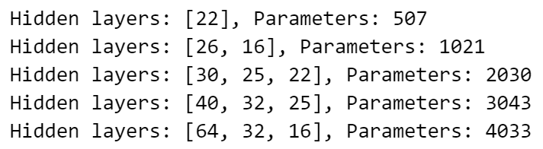
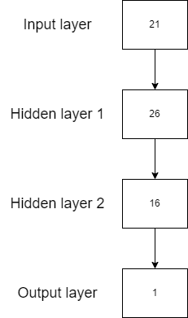
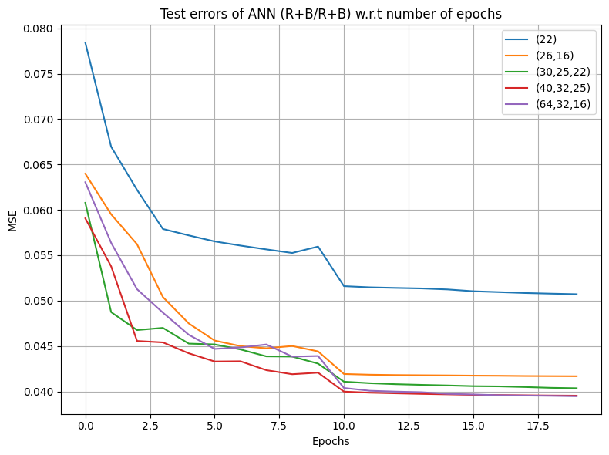
Implementation of ANN model – ANN model
An example
Different architectures of hidden layers:
Todo: Pick the best architecture and train the model with 7 combinations of training set/test set.

Slide 17
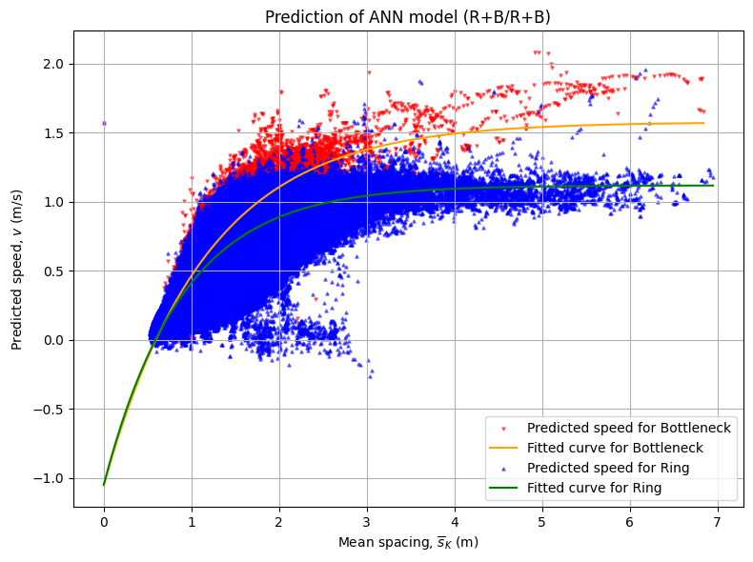
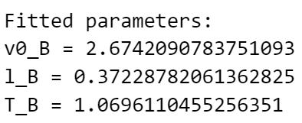
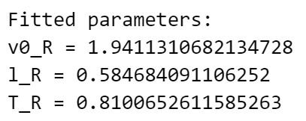


Implementation of ANN model – Comparisons
ANN vs Weidmann:
Test errors (MSE)
Distribution of predictions w.r.t. mean spacing
3 fitted parameters $v_{0}$, l and T
Weidmann model
$$v=v_{0}\left(1−\exp\left(\frac{l−{\overline{s}}_{K}}{v_{0}T}\right)\right)$$
Using the predictions of ANN, fit the 3 parameters for both scenarios: bottleneck and ring.

Slide 18
Thanks for your attention! Questions? Please feel free to ask!

